Slide 1
GSync v2
Multiplayer Game State Synchronization Protocol
CSE361: Computer Networks • Project 2
Team members:
Rawan Hany Shaker 23P0393
Hania Soliman 23P0033
Peter Maged 23P0192
John George 23P0266
Mohamed Tarek 2300535

Slide 2
System Architecture
Server
• Authoritative state
• 20 Hz broadcasts
• Conflict resolution
↕ UDP Unicast ↕
Clients (1-4)
• Receive snapshots
• Send events
• Display grid state

Slide 3
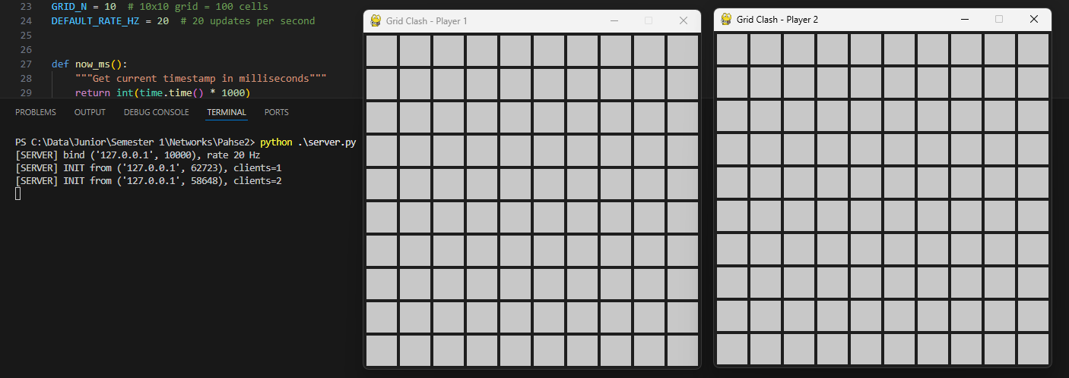

Slide 4
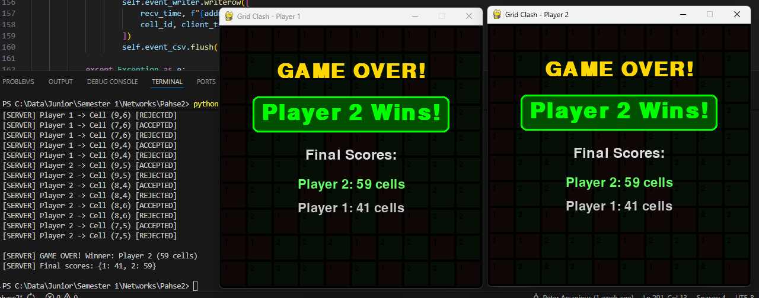

Slide 5
Protocol Header (28 Bytes)
Protocol ID (4B): "GSYN" identifier
Version (1B): Protocol version 2
Message Type (1B): INIT, SNAPSHOT, EVENT, GAME_OVER
Snapshot ID (4B): Monotonically increasing counter
Server Timestamp (8B): For latency measurement
CRC32 Checksum (4B): Error detection

Slide 6
Baseline Results (No Impairment)
Mean Latency: 0.60 ms (target ≤50 ms) ✅
Delivery Rate: 100% (target ≥99%) ✅
CPU Usage: 2-5% (efficient) ✅
Bandwidth: ~24 kbps per client
Packets Sent: 24,162 over 60 seconds

Slide 7
Under 2% Packet Loss (LAN)
Mean Latency: 0.52 ms (target ≤75 ms) ✅
Delivery Rate: 97.90% (target ≥95%) ✅
K=3 Redundancy Effect: Recovers isolated drops
User Experience: Smooth gameplay maintained

Slide 8
Under 5% Packet Loss (WAN)
Mean Latency: 0.61 ms (target ≤100 ms) ✅
Delivery Rate: 94.67% (target ≥90%) ✅
Jitter: 7.51 ms mean (occasional gaps when bursts exceed K=3)
System Stability: Remains playable with interpolation

Slide 9
Under 100ms Fixed Delay (WAN)
Mean Latency: 95.36 ms (reflects network delay)
Delivery Rate: 100% (no loss) ✅
Jitter: 4.78 ms (well-controlled)
Gameplay Impact: Acceptable for real-time games

Slide 10
All Tests Passed ✅
Baseline
0.60 ms latency
100% delivery
2% Loss
0.52 ms latency
97.90% delivery
5% Loss
0.61 ms latency
94.67% delivery
100ms Delay
95.36 ms latency
100% delivery

Slide 11
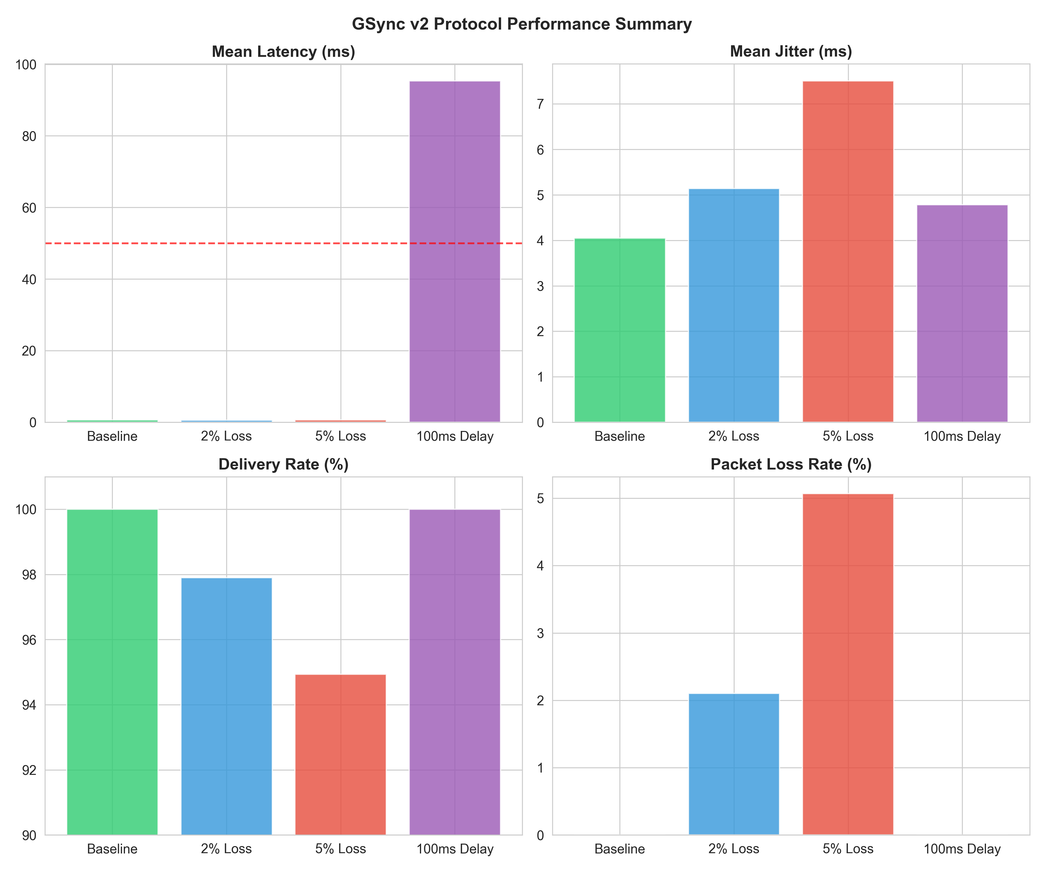

Slide 12
Reliability Mechanisms
K=3 Redundancy: Recover from isolated packet loss
Timestamp-Based Reordering: Handle out-of-order packets
CRC32 Checksum: Detect bit-flip errors
Double-Send Events: Client sends critical events twice
Client-Side Filtering: Discard outdated/duplicate snapshots

Slide 13
Questions?
Repo link: https://github.com/mo7amedmengasu/Grid-Clash-networking_project-.git
Demo video link: https://youtu.be/vrWtwm25VR4
GSync v2 Team | CSE361: Computer Networks | December 23, 2025

